Slide 1
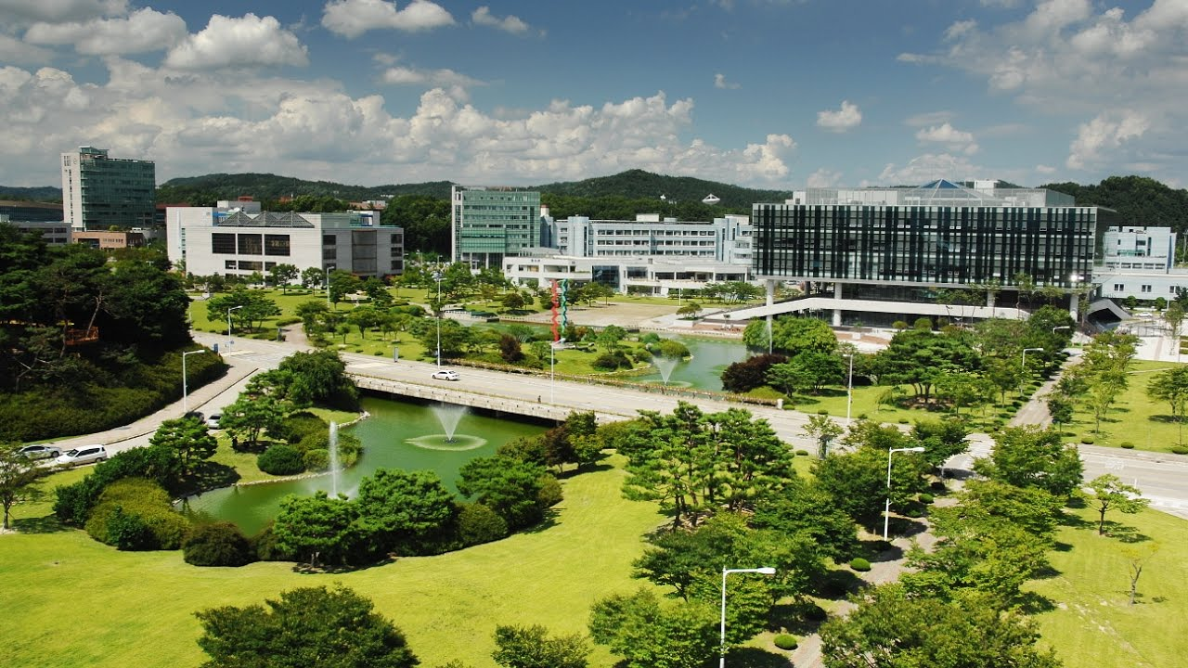
Emergency Alert System
for Campus Safety
Team CS4CS (CS for Campus Safety)
Eunhyouk Shin, Taehyung Kwon, Inyoung Cho
Notes:
Hello we are CS4CS, and we made emergency alert system for campus safety

Slide 2

Recently, Mercury Bottle Spilled
Announced 2 days after the accident
Notes:
Unfortunately, bottle of Mercury was spilled a few days ago.
But announcement was uploaded after 2 days in kaist portal.

Slide 3
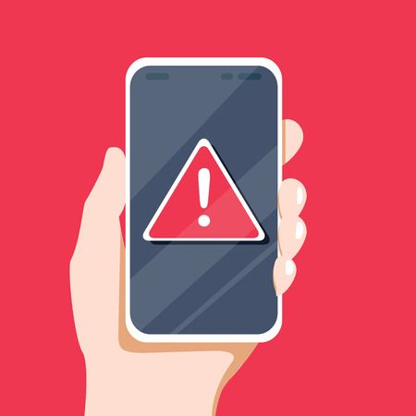
We Need an Alert System for Our Campus!
There is a risk of safety accidents on campus.
Protect people with alarm system based on user participation.
Notes:
As you have seen, There is a risk of safety accidents on campus
Therefore, we should protect people with alarm system based on user participation

Slide 4
Problems & Design Goals
<div class="Box position-absolute overflow-hidden d-none jump-to-suggestions js-jump-to-suggestions-container">
<ul class="d-none js-jump-to-suggestions-template-container">
<li class="d-flex flex-justify-start flex-items-center p-0 f5 navigation-item js-navigation-item">
<a tabindex="-1" class="no-underline d-flex flex-auto flex-items-center p-2 jump-to-suggestions-path js-jump-to-suggestion-path js-navigation-open" href="">
<div class="jump-to-octicon js-jump-to-octicon mr-2 text-center d-none">
<svg height="16" width="16" class="octicon octicon-repo flex-shrink-0 js-jump-to-octicon-repo d-none" title="Repository" aria-label="Repository" viewBox="0 0 12 16" version="1.1" role="img"><path fill-rule="evenodd" d="M4 9H3V8h1v1zm0-3H3v1h1V6zm0-2H3v1h1V4zm0-2H3v1h1V2zm8-1v12c0 .55-.45 1-1 1H6v2l-1.5-1.5L3 16v-2H1c-.55 0-1-.45-1-1V1c0-.55.45-1 1-1h10c.55 0 1 .45 1 1zm-1 10H1v2h2v-1h3v1h5v-2zm0-10H2v9h9V1z"/></svg>
<svg height="16" width="16" class="octicon octicon-project flex-shrink-0 js-jump-to-octicon-project d-none" title="Project" aria-label="Project" viewBox="0 0 15 16" version="1.1" role="img"><path fill-rule="evenodd" d="M10 12h3V2h-3v10zm-4-2h3V2H6v8zm-4 4h3V2H2v12zm-1 1h13V1H1v14zM14 0H1a1 1 0 0 0-1 1v14a1 1 0 0 0 1 1h13a1 1 0 0 0 1-1V1a1 1 0 0 0-1-1z"/></svg>
<svg height="16" width="16" class="octicon octicon-search flex-shrink-0 js-jump-to-octicon-search d-none" title="Search" aria-label="Search" viewBox="0 0 16 16" version="1.1" role="img"><path fill-rule="evenodd" d="M15.7
Notes:
From now on, I will tell you existing systems’ problem and our design goals to solve them.

Slide 5
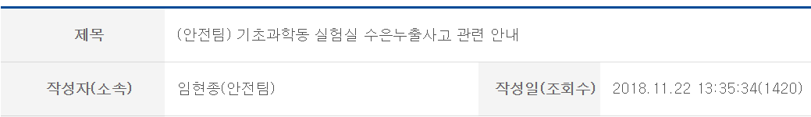
School Alarm: Depends on School Officials
Decision process takes lots of time
Risk of late alarm !!!
Notes:
In the case of School alarm, it depends only on school officials. Decision process for alarm takes lots of time.
It leads to risk of late alarm

Slide 6






Goal 1: Direct Alarm from Reporter to People
With an accessible mobile app
Safety Team
Receiver
Reporter
Notes:
So our first goal is a direct alarm from reporter to both safety team and receiver, using accessible mobile app

Slide 7

Direct Alarm: False Positive
Weak to fake report!!
Notes:
But direct alarm is weak to fake report as you previously mentioned

Slide 8
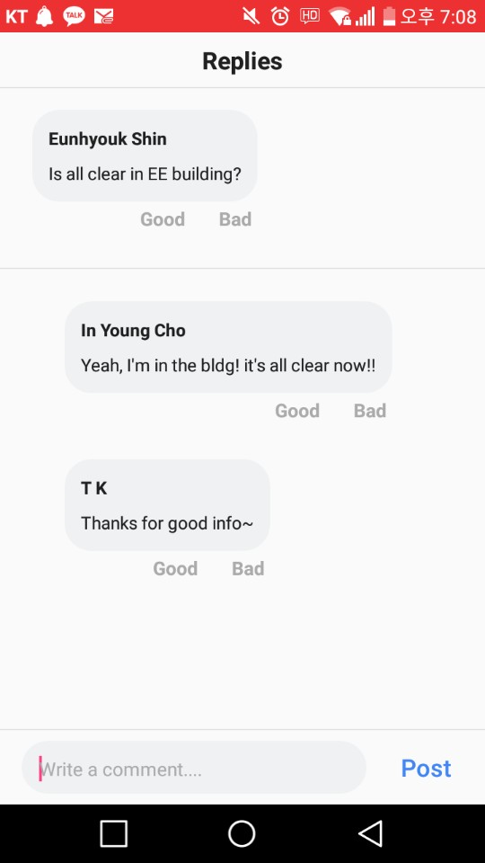
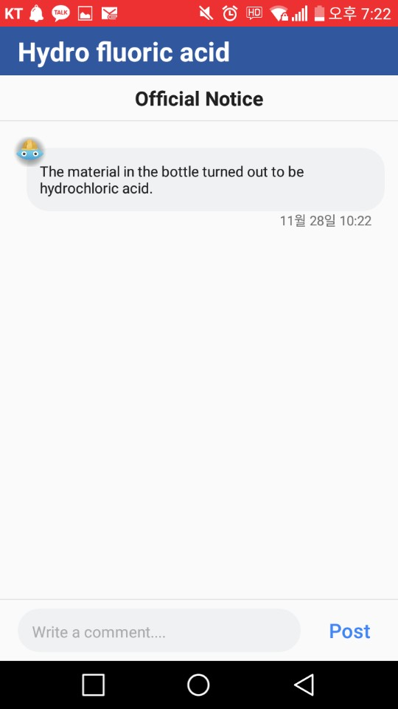
Goal 2: Feedback from User and Safety Team
User comment board
Safety team announcement
Notes:
So our second goal is to take advantage of feedbacks form user and safety team.
User are able to suggest additional info with comment board
Safety team announces the actual fact and process of handling the accident.

Slide 9
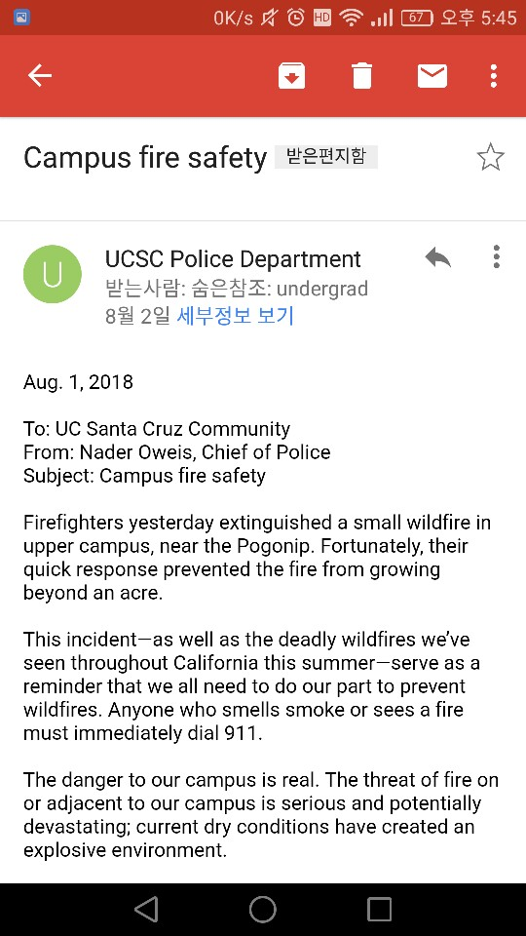
School Alarm: Mailing Lists Are Not Good Enough
School alerts are based on mailing lists
ex) EE department students
But mailing list may not cover all people who are at risk
ex) CS student visiting EE building
Notes:
School alerts are often based on mailing lists
such as list of EE department students for example.
But the problem is that mailing list may not cover all people who are at risk
such as CS student visiting EE building.

Slide 10

Goal 3: Alert Based on Physical Location
Send alarm to users nearby the accident
Notes:
So our third goal is to alert based on physical location.
We send alarm to users nearby the accident.

Slide 11
Video & Live Demo
<div class="Box position-absolute overflow-hidden d-none jump-to-suggestions js-jump-to-suggestions-container">
<ul class="d-none js-jump-to-suggestions-template-container">
<li class="d-flex flex-justify-start flex-items-center p-0 f5 navigation-item js-navigation-item">
<a tabindex="-1" class="no-underline d-flex flex-auto flex-items-center p-2 jump-to-suggestions-path js-jump-to-suggestion-path js-navigation-open" href="">
<div class="jump-to-octicon js-jump-to-octicon mr-2 text-center d-none">
<svg height="16" width="16" class="octicon octicon-repo flex-shrink-0 js-jump-to-octicon-repo d-none" title="Repository" aria-label="Repository" viewBox="0 0 12 16" version="1.1" role="img"><path fill-rule="evenodd" d="M4 9H3V8h1v1zm0-3H3v1h1V6zm0-2H3v1h1V4zm0-2H3v1h1V2zm8-1v12c0 .55-.45 1-1 1H6v2l-1.5-1.5L3 16v-2H1c-.55 0-1-.45-1-1V1c0-.55.45-1 1-1h10c.55 0 1 .45 1 1zm-1 10H1v2h2v-1h3v1h5v-2zm0-10H2v9h9V1z"/></svg>
<svg height="16" width="16" class="octicon octicon-project flex-shrink-0 js-jump-to-octicon-project d-none" title="Project" aria-label="Project" viewBox="0 0 15 16" version="1.1" role="img"><path fill-rule="evenodd" d="M10 12h3V2h-3v10zm-4-2h3V2H6v8zm-4 4h3V2H2v12zm-1 1h13V1H1v14zM14 0H1a1 1 0 0 0-1 1v14a1 1 0 0 0 1 1h13a1 1 0 0 0 1-1V1a1 1 0 0 0-1-1z"/></svg>
<svg height="16" width="16" class="octicon octicon-search flex-shrink-0 js-jump-to-octicon-search d-none" title="Search" aria-label="Search" viewBox="0 0 16 16" version="1.1" role="img"><path fill-rule="evenodd" d="M15.7
Notes:
Now, you may wanna see our implementation result
and how it meets the specifications,

Slide 12
Implementations & Benefits
Notes:
let’s watch this video demonstrating our implementation and the benefits.
…
Thank you for watching

Slide 13

Live Demo
Reporting accident in N1 building
You can hear a siren when accident is reported nearby.
Notes:
Now we prepared a live demo of reporting an accident in this building.
--liiive--
You can hear the siren, so our alert system works properly

Slide 14
Video Demo: Approaching User
No immediate alarm for user outside the danger circle.
Trigger alarm to user who walks in later.
Notes:
Now, some of you might get worried.
“what if a person was not in the danger circle, but walks in later?”
But don’t worry! We also covered this case.
here is a video demo.

Slide 15
Conclusion
<div class="Box position-absolute overflow-hidden d-none jump-to-suggestions js-jump-to-suggestions-container">
<ul class="d-none js-jump-to-suggestions-template-container">
<li class="d-flex flex-justify-start flex-items-center p-0 f5 navigation-item js-navigation-item">
<a tabindex="-1" class="no-underline d-flex flex-auto flex-items-center p-2 jump-to-suggestions-path js-jump-to-suggestion-path js-navigation-open" href="">
<div class="jump-to-octicon js-jump-to-octicon mr-2 text-center d-none">
<svg height="16" width="16" class="octicon octicon-repo flex-shrink-0 js-jump-to-octicon-repo d-none" title="Repository" aria-label="Repository" viewBox="0 0 12 16" version="1.1" role="img"><path fill-rule="evenodd" d="M4 9H3V8h1v1zm0-3H3v1h1V6zm0-2H3v1h1V4zm0-2H3v1h1V2zm8-1v12c0 .55-.45 1-1 1H6v2l-1.5-1.5L3 16v-2H1c-.55 0-1-.45-1-1V1c0-.55.45-1 1-1h10c.55 0 1 .45 1 1zm-1 10H1v2h2v-1h3v1h5v-2zm0-10H2v9h9V1z"/></svg>
<svg height="16" width="16" class="octicon octicon-project flex-shrink-0 js-jump-to-octicon-project d-none" title="Project" aria-label="Project" viewBox="0 0 15 16" version="1.1" role="img"><path fill-rule="evenodd" d="M10 12h3V2h-3v10zm-4-2h3V2H6v8zm-4 4h3V2H2v12zm-1 1h13V1H1v14zM14 0H1a1 1 0 0 0-1 1v14a1 1 0 0 0 1 1h13a1 1 0 0 0 1-1V1a1 1 0 0 0-1-1z"/></svg>
<svg height="16" width="16" class="octicon octicon-search flex-shrink-0 js-jump-to-octicon-search d-none" title="Search" aria-label="Search" viewBox="0 0 16 16" version="1.1" role="img"><path fill-rule="evenodd" d="M15.7
Notes:
Now, you may wonder the implementation result
and how it realizes the initial specifications that we mentioned,

Slide 16
People Asked Us….
“Why don’t you just notify every people of an accident?”
Great!
We also want to! However….
Notes:
So far we introduced our solution and its implementation results
but still p
could be the best

Slide 17
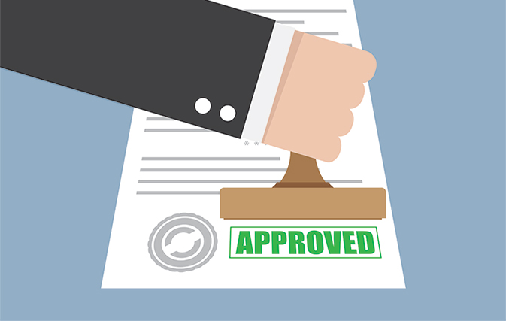
Class Project to the Real World
We want to apply our good solution to the real world
Have to consider whether the school approve this solution
Notes:
just making a solution is not enough
in that case,
http://www.travelweek.ca/news/travelbrands-creditors-approve-plan/

Slide 18
School Wants Careful Actions
안녕하세요?
안전팀장 이상철입니다.
올 들어 우리학교에서 여러 건의 실험실 사고가 있었지만
이처럼 포털에 사고사실을 알리는 경우는 극히 이례적입니다.
그럼에도, 본래 목적과 다르게 왜곡, 확대재생산, 사실관계 확인 없는 기사화 등의 부작용을 경계하여 더욱 신중한 대처가 필요합니다.
“it is very exceptional to notify an accident in Portal”
“side effects such as hasty newspaper prints”
Don’t want to make unnecessary confusion
Notes:
email from the security team

Slide 19
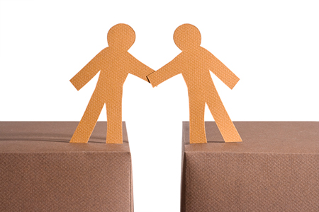
Need Compromise
Direct alert
Only to nearby users
And approaching users
For now, even a direct alert system can be a big step forward
Notes:
https://rismedia.com/2017/05/29/using-compromise-create-happy-homebuyers/#close
Even a direct alert system can be a big step forward

Slide 20
The Future of Our Journey
In the end,
Approved and supported by the security team and chief administrative officer
Plan to apply core ideas to the school system
Not just stay as a class project
Notes:
어푸르브드, 치프
our idea will not just stay

Slide 21

To The Real World,
CS4CS
Notes:
https://wallhere.com/en/wallpaper/780571

